Slide 1

DIGITAL LETTER BOX
SUBMITTED TO:
ER NISHI
(COORDINATOR CSE)
SUBMITTED BY: PALAK AGGARWAL
11501311
BTECH CSE
(5C)

Slide 2
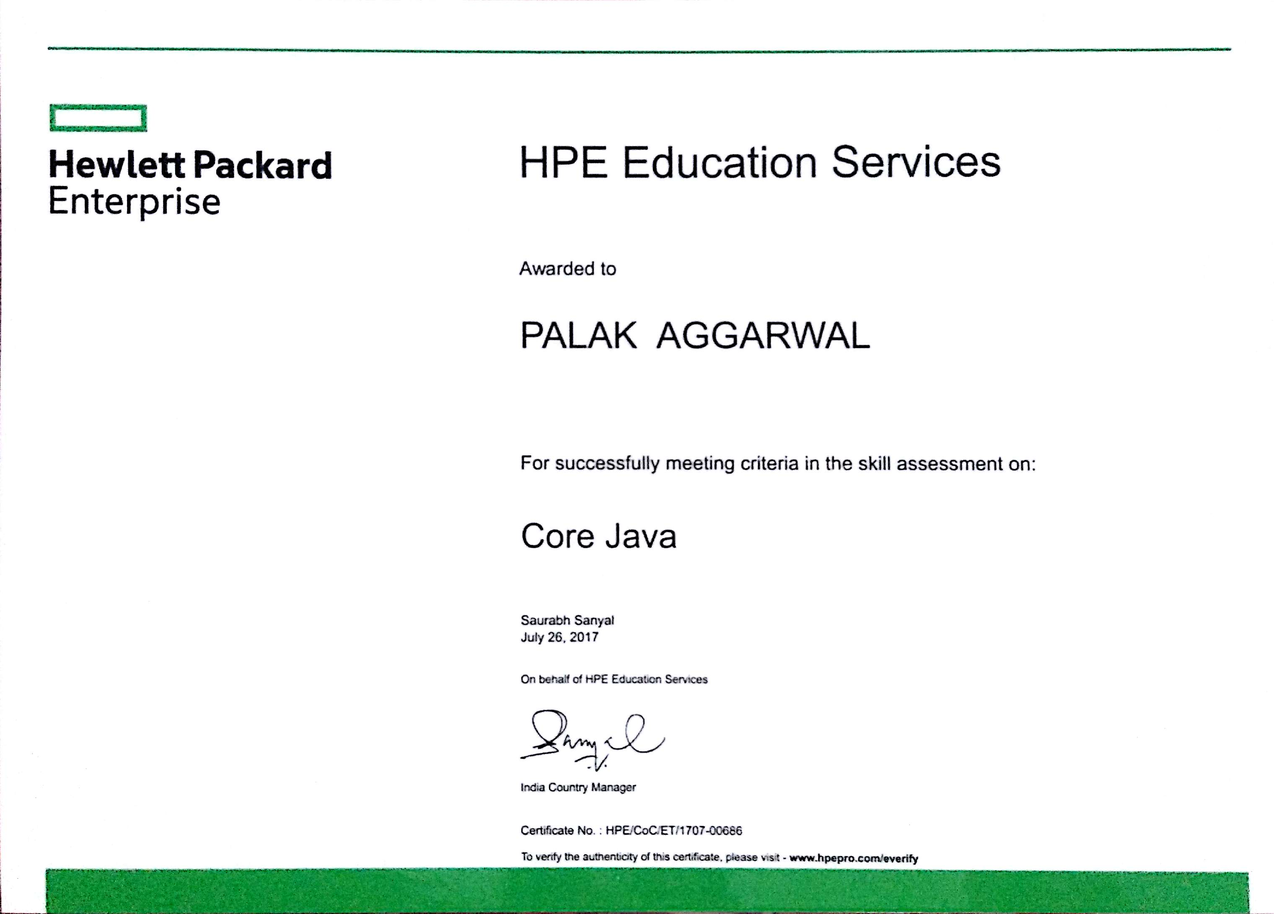

Slide 3
CONTENTS
Objective of Digital Letter Box
Background
Java
Features of Java
Applications of Java
Hewlett Packard Enterprises
Why HPE For Training
Definition
Overview
Specifications
Working

Slide 4
OBJECTIVES OF DIGITAL LETTER BOX
To digitise the procedure of submitting applications.
To facilitate sending of any kind of applications like scholarship application, complaint applications, hostel change applications or any other application you want to send.
To minimize human effort as sending application online instead of wandering here and there to submit application.
To save time for wandering to submit application in search of the person to whom application to be submitted or other resources like hardcopy print outs etc.

Slide 5
BACKGROUND
“Digital Letter Box” is coded in core java programming language, with the help of staff members of Hewlett Packard Enterprises.
Tools used for its development are following:
NetBeans v8.2(IDE)
Wamp SQL server
This is basically for universities or some big organisations so that for submitted applications to any of the higher authorities became a easy task.

Slide 6
JAVA
1) James Gosling, Mike Sheridan, and Patrick Naughton initiated the Java language project in June 1991. The small team of sun engineers called Green Team.
2) Firstly, it was called "Greentalk" by James Gosling and file extension was .gt.
3) After that, it was called Oak as Oak is a symbol of strength and chosen as a national tree of many countries like U.S.A., France, Germany, Romania etc. and was developed as a part of the Green project.
4) In 1995, Oak was renamed as "Java" because it was already a trademark by Oak Technologies.
5)They wanted something that reflected the essence of the technology: revolutionary, dynamic, lively, cool, unique, and easy to spell and fun to say. According to James Gosling "Java was one of the top choices along with Silk". Since java was so unique, most of the team members preferred java
6) Java is an island of Indonesia where first coffee was produced (called java coffee).
7) In 1995, Time magazine called Java one of the Ten Best Products of 1995.
8) JDK 1.0(Java Development Kit version 1.0) released in (January 23, 1996).

Slide 7
9)There are various versions of Java has been released till today. Current available release of Java is Java SE8.
The Java Development Kit (JDK) is a software development environment used for developing Java applications and applets. It includes the Java Runtime Environment (JRE), an interpreter/loader (java), a compiler (javac), an archiver (jar), a documentation generator (javadoc) and other tools needed in Java development.
JVM
A specification where working of Java Virtual Machine is specified. But implementation provider is independent to choose the algorithm. Its implementation has been provided by Sun and other companies.
An implementation Its implementation is known as JRE (Java Runtime Environment).
Runtime Instance Whenever you write java command on the command prompt to run the java class, an instance of JVM is created.

Slide 8
FEATURES OF JAVA

Slide 9
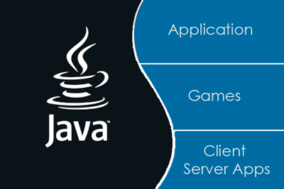
APPLICATIONS OF JAVA

Slide 10
There are many places where Java is used in real world, starting from commercial e-commerce website to android apps, from scientific application to financial applications like electronic trading systems, from games like Minecraft to desktop applications like Eclipse, Netbeans and IntelliJ, from open source library to J2ME apps etc. Let's see each of them in more detail.

Slide 11

HPE Authorized Education Delivery Partners gives experience to work with supremacy companies to deliver training’s and meet the requirements of learning partners. HPE Authorized Education Delivery Partner has permission and authorization to meet the HPE standards approved with course ware to complete the level of competency required for certification.
HPE help customers to use technology to slash the time it takes to turn ideas into value. In turn, they transform industries, markets and lives. Some of their customers run traditional IT environments. Most are transitioning to a secure, cloud-enabled, mobile-friendly infrastructure. Many rely on a combination of both. Wherever their customers are in that journey, they provide the technology and solutions to help them succeed. The advanced research from Hewlett Packard Labs changes the world.

Slide 12
WHY HPE FOR TRAINING?
HPE visited DAV University for the House Summer Training program, as company have a lot of fame over the world as well as excellent staff members like Mr Gagan Marken who is ready to help us any time impressed us. He welcome our doubts even if we call him in mid night and took our training sessions for 6 to 7 hours every day That is why I opted this company for my 6 weeks training after the 4th semester.
Work Areas
I have worked on core java. In which I worked on basic java syntax, Object Oriented Programming Concept, GUI i.e. swings, Socket Programming, Multi-Threading, File Handling.

Slide 13
DEFINITION
Digital Letter Box is one of the computer based SERVER – CLIENT application developed in core java used to send application to the any person of institution/company to whom you want to send but sender and receiver both should be members of same organisation.

Slide 14
OVERVIEW
As if we see in our university i.e. DAV University, Jalandhar is a big campus, if we have to submit any kind of application to any of the higher authorities or our teachers we have to wander a lot here and there. But using this Digital Letter Box we can easily send application any of the higher authorities/teachers.
In other words, if the live server of the organisation is connected to it than the people associated with the organisation can send or receive application by logging in to application and one who have access to receive the applications can login receive the application and accept or reject it. If accepted or rejected the status will be reflected to the sender.

Slide 15
SPECIFICATIONS
It can be implemented in any of the big or small organisation. It will help to reduce the little bit of work load from higher authorities. Moreover it will reduce the human effort and save time wasted in wandering here and there for submitting application.
Requirements
Tools used:
IDE NetBeans v8.2
JDK SE8
Wamp Server
Knowledge of Java Syntax
Programming concepts – class, packages, interfaces, swing, JDBC, Socket Programming, and File Handling
Knowledge of Database concepts

Slide 16
To send an application
You have to login with your ID assigned, password, and contact no.
Select department and teacher name as it is implemented for university.
Enter application subject.
Attach application File.
Click on submit to send.
Accepted or rejected status will be reflected to you in the sent box.
For receiver end
Firstly login
Check application
Click on subject to download the file
Click on accept or reject as per the choice
It require database of organisation

Slide 17
WORKING
MODULE I – CLIENT END/
SENDER END

Slide 18
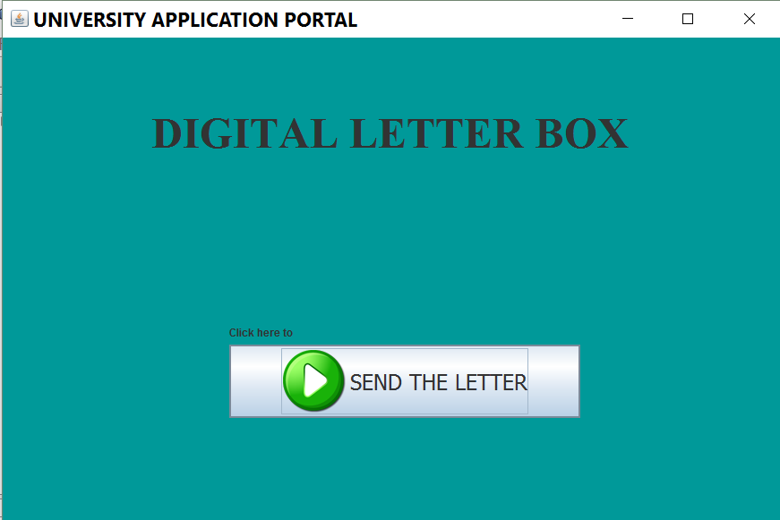
WELCOME FRAME
When we run the project at client side this frame will popup. Click on send a letter button to login.

Slide 19
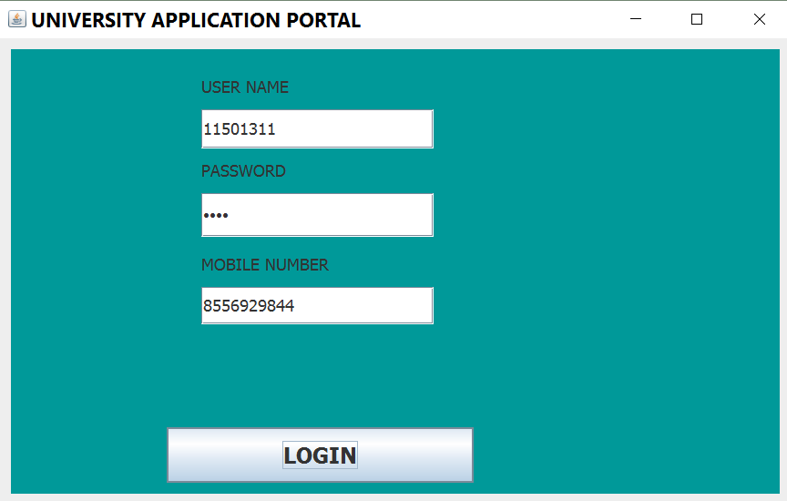
LOGIN FRAME
Here the sender will login to send application. User name and password will be matched from Student_data database connected at back end and contact no. will be updated to database.

Slide 20
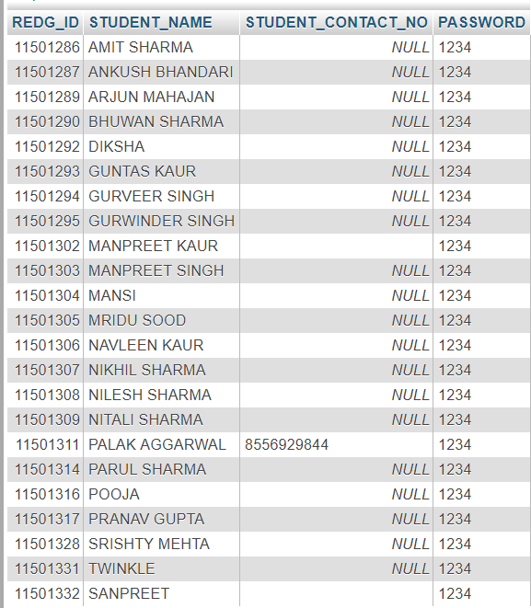
STUDENT DATABASE
Client will be able to login only if the user id of sender matches REDG_ID to this database and password matches with PASSWORD corresponding to the REDG_ID. Contact number will be updated here in STUDENT_CONTACT_NO.

Slide 21
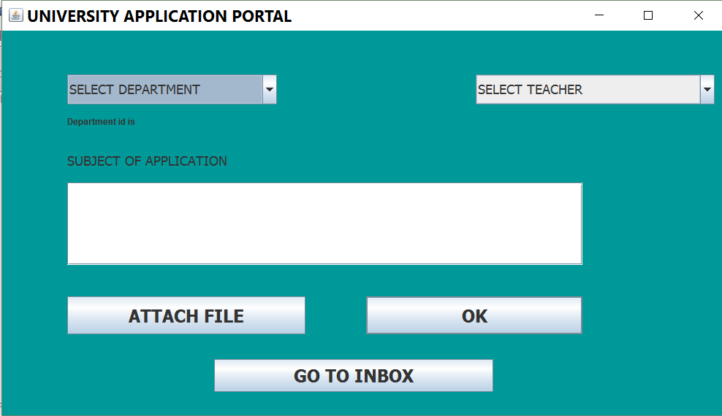
COMPOSE APPLICATION FRAME
Here sender will compose the application. Department in combo box will come from department database.
In next combo box teachers will be display from teacher database of corresponding department.
Then subject of application will go in text area.

Slide 22
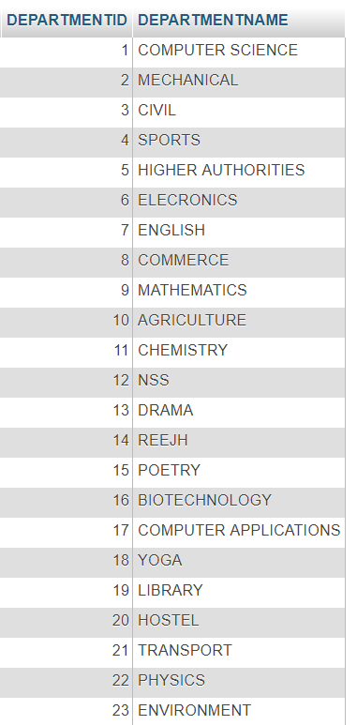
DEPARTMENT DATABASE
This database will give department names to the combobox1 in the above frame

Slide 23
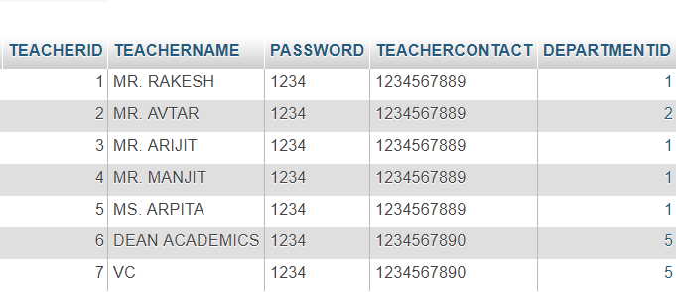
TEACHER DATABASE
This database will give teacher data corresponding to department selected in combo box 2 in frame below.

Slide 24
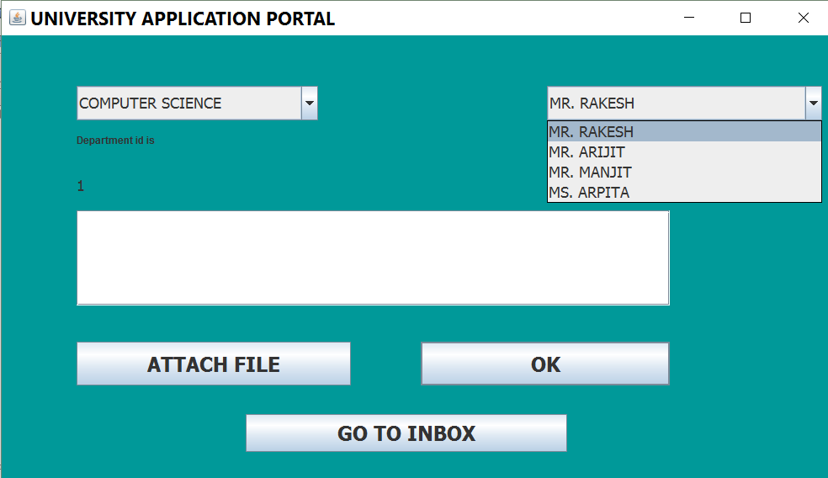
FILLING DETAILS TO SEND APPLICATION
Here in to combo box data comes from teacher database corresponding to department selected. Go to inbox button will directly take you to the applications you have sent

Slide 25
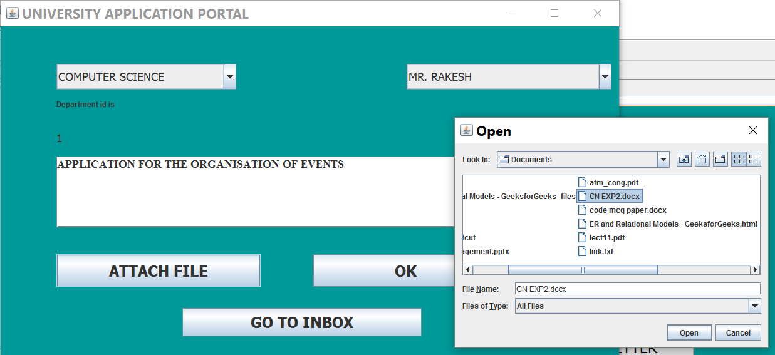
CHOOSING FILE TO BE SENT
After giving application subject attach application file by clicking on attach file button and this frame will pop up from where application to be selected. After file selection click on OK button which will update all this data to the application database.

Slide 26
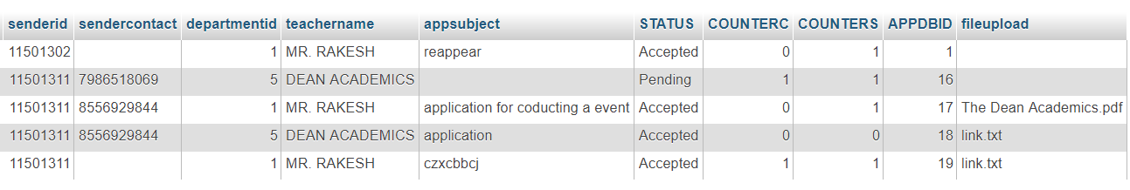
APPLICATION DATABASE
It contains all the applications details that are send by whom contact number of sender. Application subject it status will be pending when it is just sent not accepted or rejected will change as per the receiver response. File upload will contain the file attached. Application id will have unique id for each application. Counters and counterc will manage data to be displayed at both ends

Slide 27
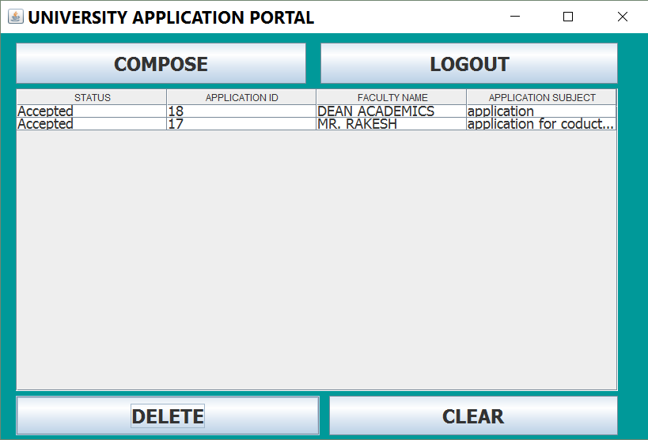
SENT BOX
This will display all the application sent by the user.
Compose will let you compose new application. logout will take you out of you id. Delete will clear selected row and clear will clear all the data.

Slide 28
MODULE II – SERVER
END/RECEIVER END

Slide 29
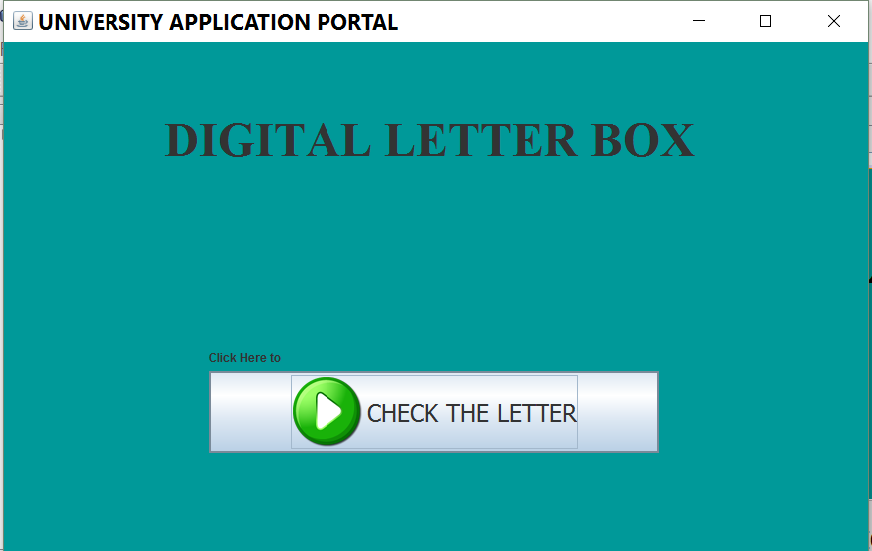
WELCOME FRAME
When we run the project at client side this frame will popup. Click on send a letter button to login.

Slide 30
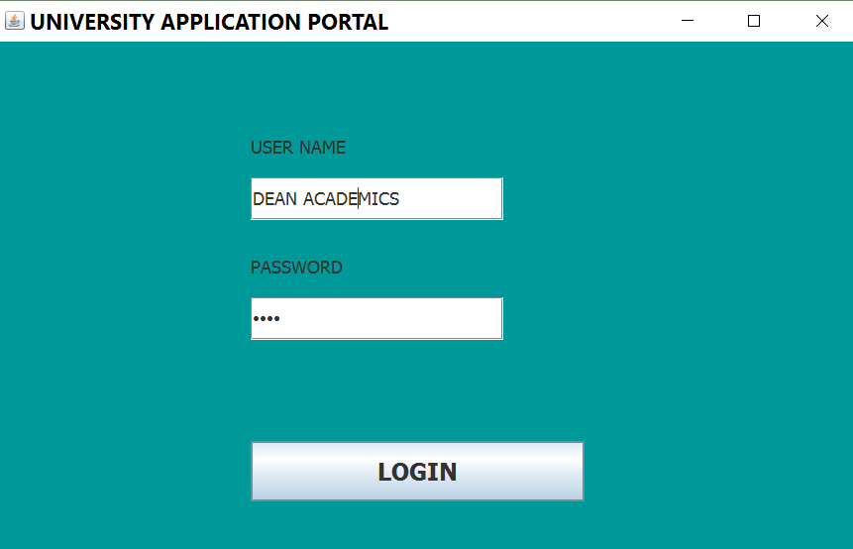
LOGIN FRAME
This will take the user name and id from teacher database to login.

Slide 31
TEACHER DATABASE
It is used to match data in login frame of server end. If it matches the data then user will be allowed.

Slide 32
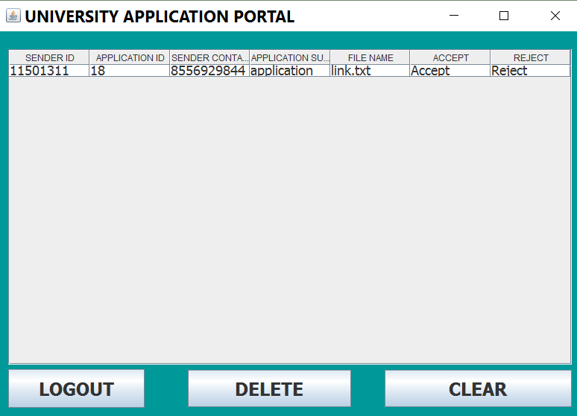
INBOX FRAME
Here data will come from application database. If receiver will click on file name file will downloaded to the location you choose and if accept is clicked application status will be accepted similarly, reject will work and after accept or reject particular row will be cleared from inbox. Clear button will clear the inbox. Delete button will clear selected row. Logout will let you come out of you id.

Slide 33
APPLICATION DATABASE
It contains all the applications details that are send by whom contact number of sender. Application subject it status will be pending when it is just sent not accepted or rejected will change as per the receiver response. File upload will contain the file attached. Application id will have unique id for each application. Counters and counterc will manage data to be displayed at both ends

Slide 34
CONCLUSION
At last, I conclude that this project will be very beneficial if implemented. It will save lot of our time and efforts. But at the same time I consider this project as an “Incremental Software Process Model”, this is the basic version of the “Digital letter box”, in future I would be coming up with more enhanced features of this project and will try to make it Android based.
I strongly recommend that this project should be implemented in our university, so that my efforts would really get successful.

Slide 35
REFERENCES
http://javarevisited.blogspot.com/2014/12/where-does-java-used-in-real-world.html#ixzz4s9si71J4
www.javatpoint.com
www.tutorialspoint.com/java
www.geeksforgeeks.org/java/
www.oracle.com/java/
www.techopedia.com/
www.stackoverflow.com/documentation/java/topics

Slide 36
THANK YOU

